Slide 1

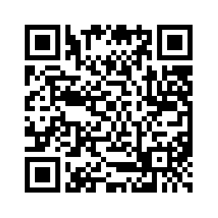

http://www.comp.nus.edu.sg/~cs2100/
Welcome to CS2100
(AY2024/25 Semester 2)
QnA website

Slide 2
Welcome to CS2100
Lecturers
Course Materials
Course Description
Assessments
Textbooks
Admin Matters
Schedule
Plagiarism Policy
Reminder: Important Dates

Slide 3
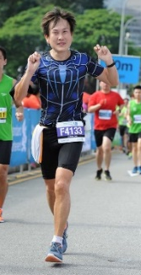
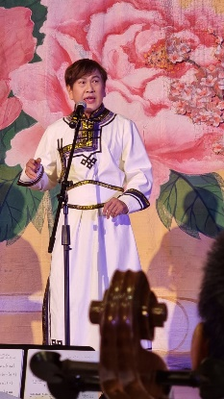
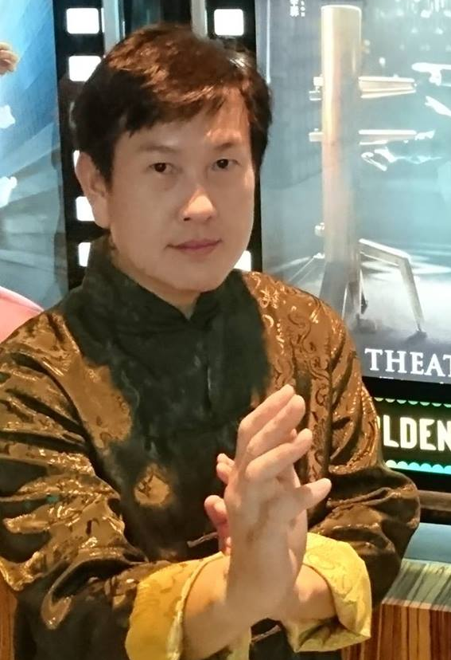
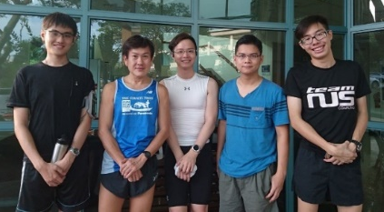
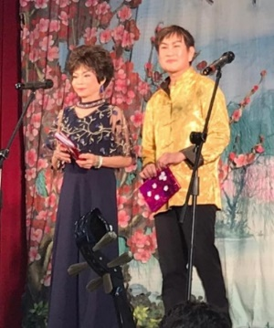
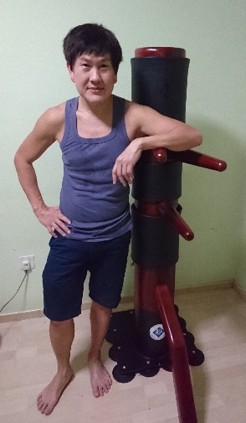
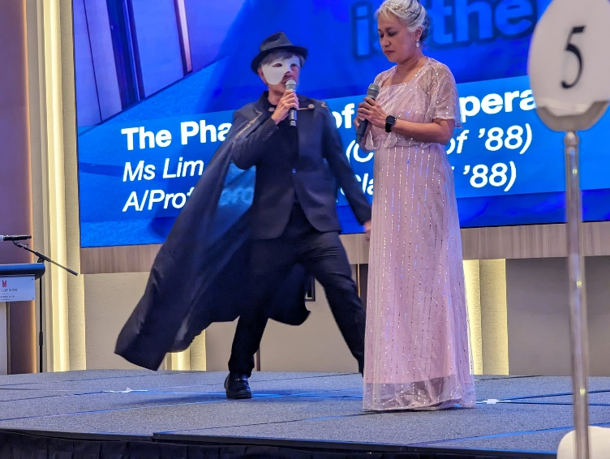
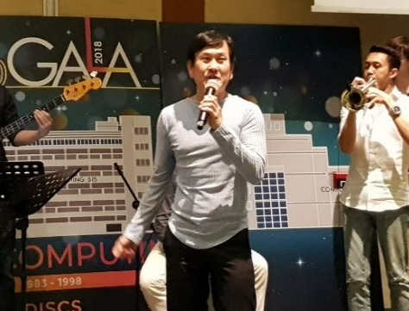
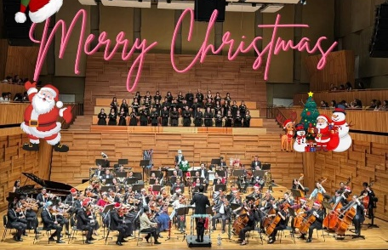
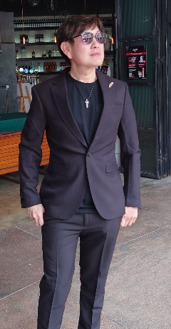
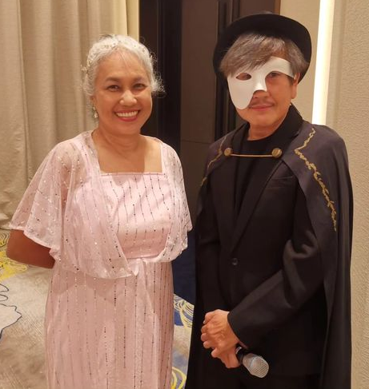
1. Lecturers (1/2)
Cantonese opera
Running
Wing Chun
Used to have weekly runs with students every week (pre-Covid days)
Nov 2024
Sep 2019
Singing
SoC Gala Dinner 2018
A/P Tan Tuck Choy, Aaron
Office: COM1-03-12
Email: tantc@comp.nus.edu.sg
Choir
Admin appointment:
Assistant Dean (Undergraduate Studies)
Winter Daydreams
Joy Chorale Choir
Dec 2024
SoC 25th Anniversary
July 2023
Sep 2022

Slide 4
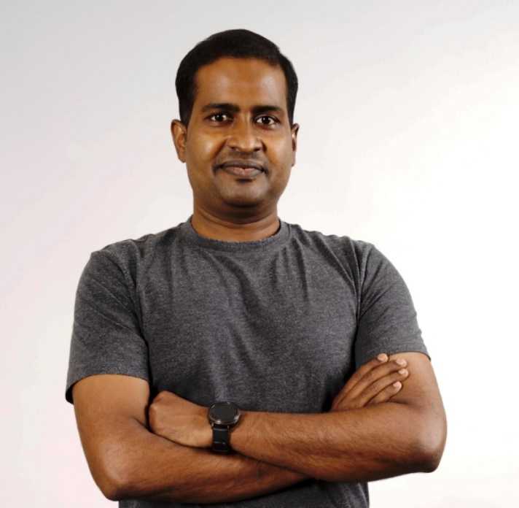
1. Lecturers (2/2)
Prabhu Natarajan
Senior Lecturer
Office: COM3 – 02 – 34
Email: prabhu@comp.nus.edu.sg
Ph.D. from School of Computing, NUS
Joined as a lecturer in SoC in 2021, promoted to Senior Lecturer in 2024
Modules taught in SoC: IT1244, CS2103 & CS2106
Director for CCSGP Center
Before joining NUS, I was teaching in DigiPen Institute of Technology Singapore
Annual Teaching Excellence Award (ATEA) in 2023 and 2024
Notes:
Introduction
CCSGP Website – invite them to participate in the CCSGP programme
Syllabus Overview – Canvas page
Panopto Video – Playlist
Errata - Slides

Slide 5
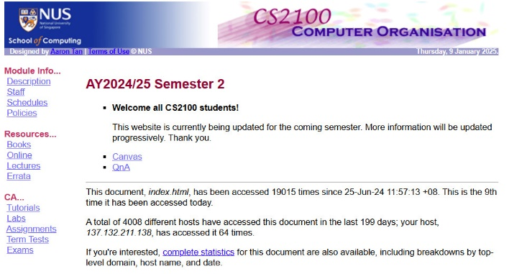
2. Course Materials
Canvas https://canvas.nus.edu.sg
CS2100 website (in case Canvas is down)
https://www.comp.nus.edu.sg/~cs2100
Credit for Lecture Materials
All materials used in this course are from A/P Aaron Tan

Slide 6
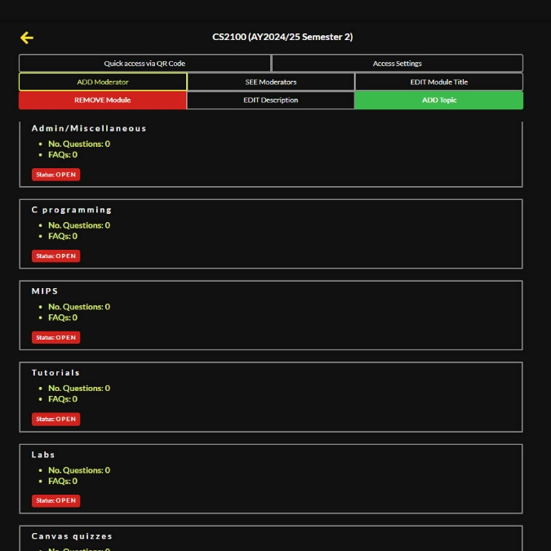
2. Course Materials
SeTs.netlify QnA website https://sets.netlify.app/module/676ca3a07d7f5ffc1741dc65
For students to post queries
Divided into topics

Slide 7
3. Course Description (1/5)
The objective of this module is to familiarise students with the fundamentals of computing devices
The basics of data representation
How the various parts of a computer work, separately and with each other
Topics
C programming language
Data representation and number systems
Assembly language
Processor datapath and control
Pipelining
Cache
Combinational and sequential circuit design

Slide 8
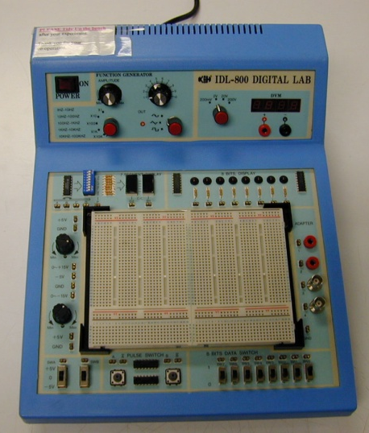
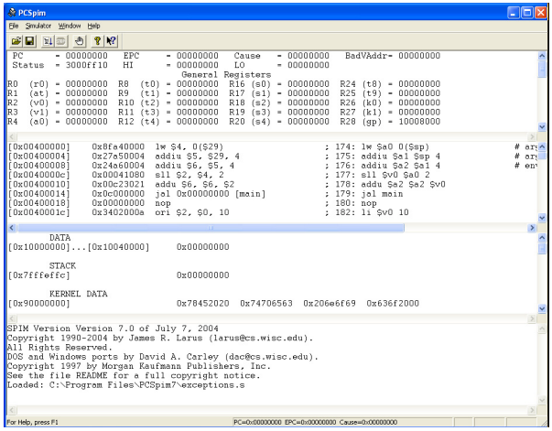
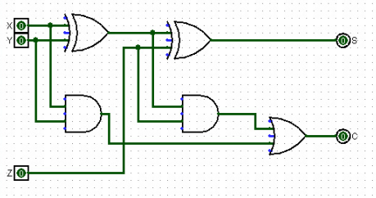
3. Course Description (2/5)
Practical aspects
C debugger
QTSpim software
Logic design experiments
Logisim software

Slide 9
3. Course Description (3/5)
Hardware/Software Stack in Computer
CS4212
Application software
CS2106
Compiler
Software
Assembler
Operating System
Linker
Loader
Scheduler
Device Drivers
Instruction Set Architecture (ISA)
Processor
Memory
I/O System
Datapath & Control Design
Hardware
Digital Logic Design
CS2100
Circuit Design
Transistors

Slide 10
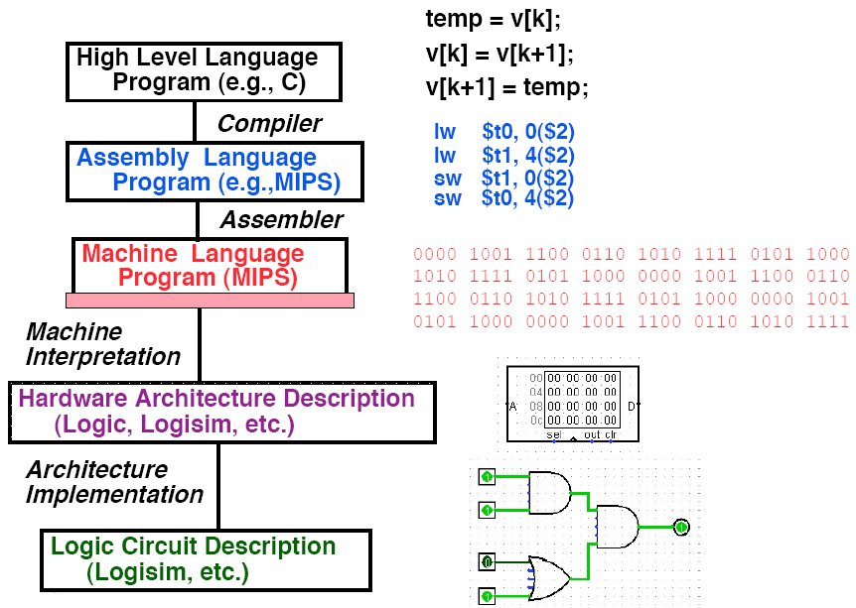
3. Course Description (4/5)
Level of Representation

Slide 11
3. Course Description (5/5)
CS2100 is not difficult ☺
CS2100 is more on the breadth rather than depth, hence there are many topics → giving the impression that the course is tough.
Theory + practice.
All topics are somewhat linked, so good understanding of earlier topics (especially the fundamentals) is important for later topics.

Slide 12
4. Assessments
CA component | Weightage
Tutorial attendance | 5%
Canvas quizzes | 3%
Three Assignments | 12%
Labs | 10%
Mid-term test * | 20%
Final exam * | 50%
* Open-book: pen-and-paper. All printed and written materials allowed. Calculators allowed. Electronic devices (apart from calculators) not allowed. More details will be given later.

Slide 13
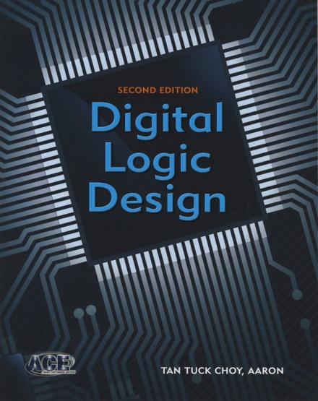
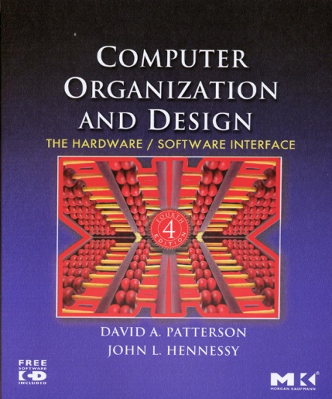
5. Textbooks
Digital Logic Design (DLD), 2nd edition by Aaron Tan, McGraw-Hill
Physical book (NUS co-op, $20+)
ebook available (Validity period for special price $17 excl. GST: 15 Jan – 28 Feb 2025) https://www.mheducation.com.sg/digital-logic-design-2e-9780071327442-asia-group
Please refer to module website “Errata” page for errors in the book.
Computer Organization and Design (COD), 4th edition by David A. Patterson and John L. Hennessy, 4th ed, Elsevier

Slide 14
Welcome
6. Admin Matters (1/4)
CS2100 is taught in Blended Learning mode.
All course materials (lecture slides, recordings, tutorial questions, lab questions, etc.) will be uploaded on Canvas week-by-week
Tutorials and labs start in Week 3 (27 January 2025)
Physical attendance is compulsory. MC required for absence.
Mid-term test
12 March 2025, Wednesday, 7 – 8:30pm.
Let us know by mid-February if it clashes with your other courses.
Please post your queries on Canvas forums or QnA website.
Everybody can help answer and everybody can read the answers
Only for personal matters: Email us at tantc@comp.nus.edu.sg (Aaron), or prabhu@comp.nus.edu.sg (Dr Prabhu).

Slide 15
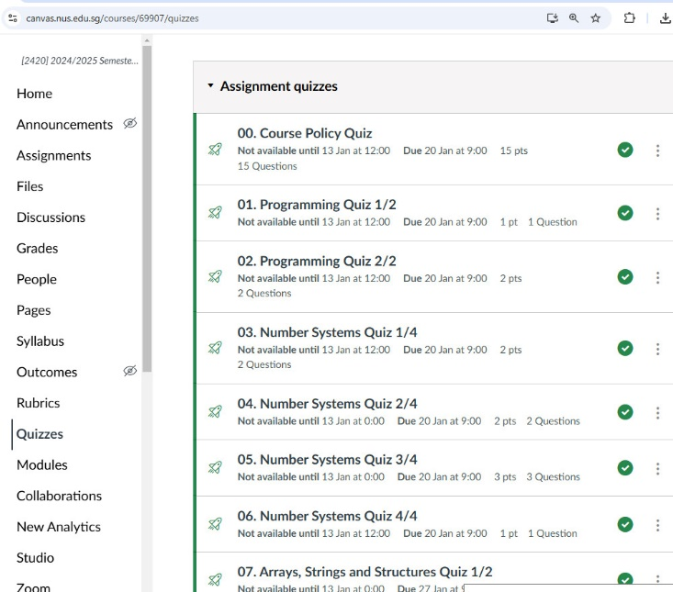
6. Admin Matters (2/4)
CS2100 is taught in Blended Learning mode.
Sequence of lectures and quizzes for the week are shown in the CS2100 “Home” screen on Canvas.
Follow the sequence of notes and do the quizzes (see left picture)
Lecture recordings are in the Videos/Panopto tool on the left of the screen.
Please view all lecture recordings and do all the quizzes for Week n before the start of Week n+1.
i.e. view all the lectures and do the quizzes for Week 2 before the start of Week 3.

Slide 16
6. Admin Matters (3/4)
We will have Recitation Sessions every Monday 10am to 12nn
Venue: LT8 and Zoom (zoom link on Canvas)
First Recitation on 13 January 2025.
What do we do at Recitation?
Every set of Lecture Notes has a QR code and a link to ask questions.
As you view the slides if you don’t understand something, you may post on QnA.
We will answer these questions during recitation.
Setlify QnA website:
https://sets.netlify.app/module/676ca3a07d7f5ffc1741dc65

Slide 17
6. Admin Matters (4/4)
Online tutorial/lab registration – through CourseReg.
Lab group and tutorial group are independent.
Appeal through CourseReg, please do NOT email us!
Priority will be given to those without a group, instead of those who already have a group but wish to change.
Do not worry if your lab/tutorial is back to back with the lecture. We will be punctual in starting our lesson and CS2100 recitations/tutorials/labs should end 15 minutes before the hour.
After you get your assigned group, please stick with it.
If you need to attend another group for just one week, please send an email to Aaron at tantc@comp.nus.edu.sg (at least a few days in advance) with your reason or attendance will not be taken by your tutor/labTA.

Slide 18
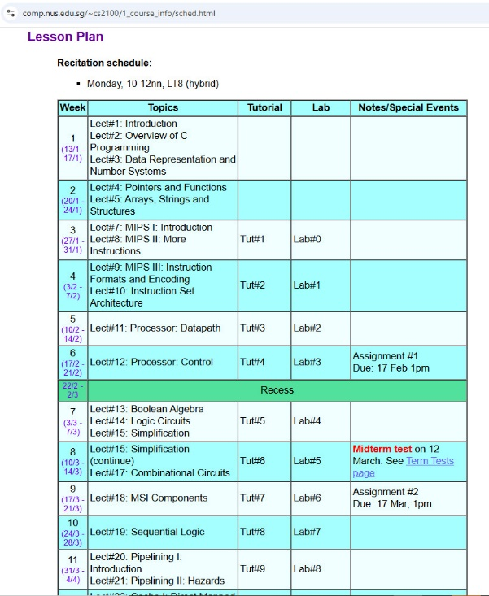
7. Schedule
Lecture slides and videos for week i will be released at the start of week i
Quiz for week i will be on Canvas at the start of week i
Canvas quizzes will be autograded
The quiz for week i will close at the start of week i + 1
Tutorials and labs for week i will be released at the start of week i - 1
The recitation for week i will cover the material as well as quiz of week i - 1
Assignments will generally be launched one week before the deadline.
Advice: Start working on it as soon as it is launched
Schedule and recitation plan are on CS2100 website:
https://www.comp.nus.edu.sg/~cs2100/1_course_info/sched.html

Slide 19
8. Plagiarism Policy
NUS takes plagiarism very seriously
Serious cases could result in expulsion from the university
Why so serious?
The reputation of NUS is at stake
Your learning outcomes are at stake
SoC is very good at detecting plagiarism
We have the tools and experience to check
Do not share your code or any solution with others even if you discuss
All quizzes, assignments, and labs are individual
When discussing, be mindful of “crossing the line”
Use of AI is strictly prohibited in this class
You need to learn the basics first “by hand”

Slide 20
9. Reminder: Important Dates
CS2100 MIDTERM TEST
12 March 2025, Wednesday, 7 – 8:30pm. Venue TBA.
CS2100 FINAL EXAM
3 May 2025, Saturday, 9 – 11am. Venue TBA.
Schedule and recitation plan are on CS2100 website:
https://www.comp.nus.edu.sg/~cs2100/1_course_info/sched.html

Slide 21
End of File

Slide 22

There are 10 types of people in this world.
Those who understand binary and those who don’t.

